Slide 1
Face Swap
Meow Meow
Team: Abhijit, Sadiq, Jonathan, Cheng-Chih

Slide 2
OUTLINE
Overview and Demo
System Architecture and Flow
Camera Image
Cat Face Cropping and BG Removal
Face Detection
Future Work

Slide 3
Overview and Demo
1
2
3
Goal
In this project, we utilized RaspberryPi 5 and camera p5v04a to capture live images and detect human faces with cv2 to return the coordinate and area of faces detected. An image with 16 emojis is prepared for cropping and background removing. After these two parts are ready, the cropped emoji will be resized and placed on the camera image.
Keywords
Raspberry Pi, Camera, Face Detection, Haar Filter, CV2, Meow Meow
Demonstration
First let’s take a look at the system performance…

Slide 4
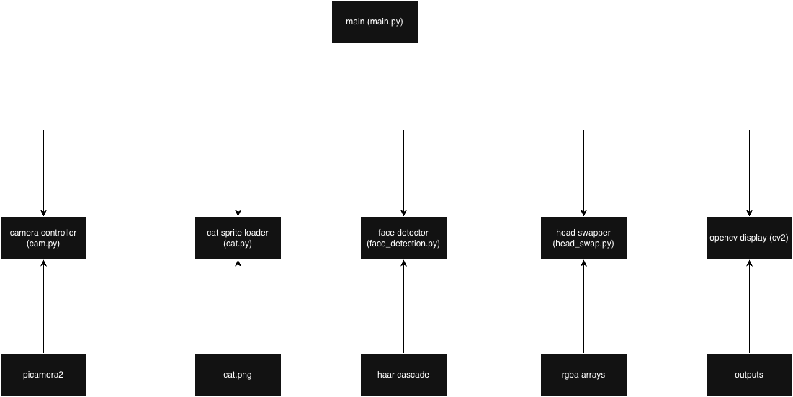
System Architecture

Slide 5
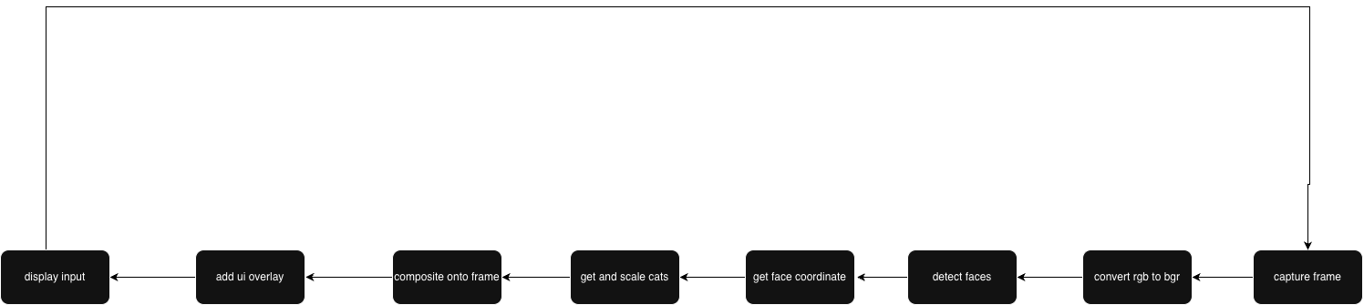
Processing Pipeline Flow

Slide 6
1
Camera and Image
Camera utilization and Cat face cropping.

Slide 7
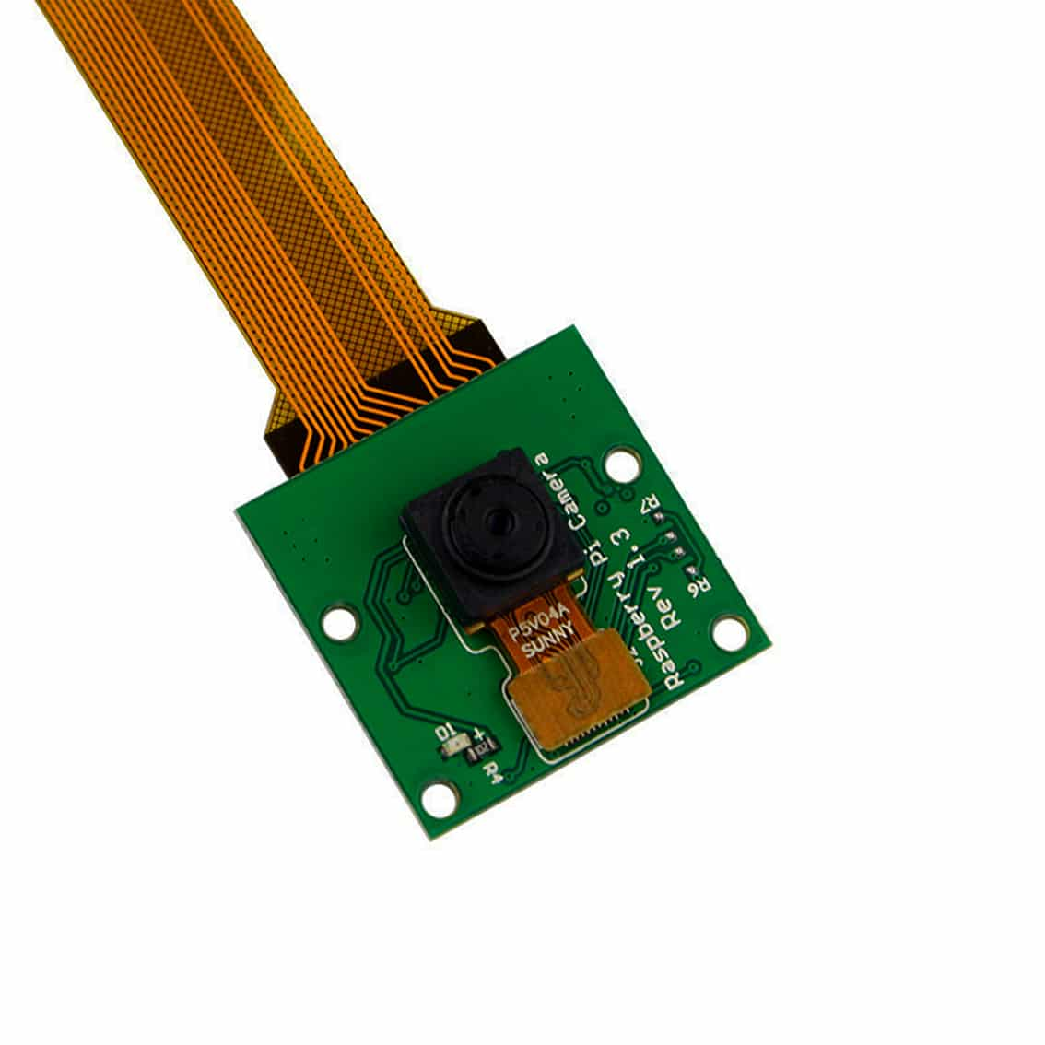
Camera p5v04a
Sensor: Omnivision OV5647 5-megapixel CMOS sensor
Still Picture Resolution:
2592×19442592 cross 1944
2592×1944 pixels
Video Support:
1080p at 30fps
720p at 60fps
640×480p640 cross 480 p
640×480p at 60/90 fps

Slide 8
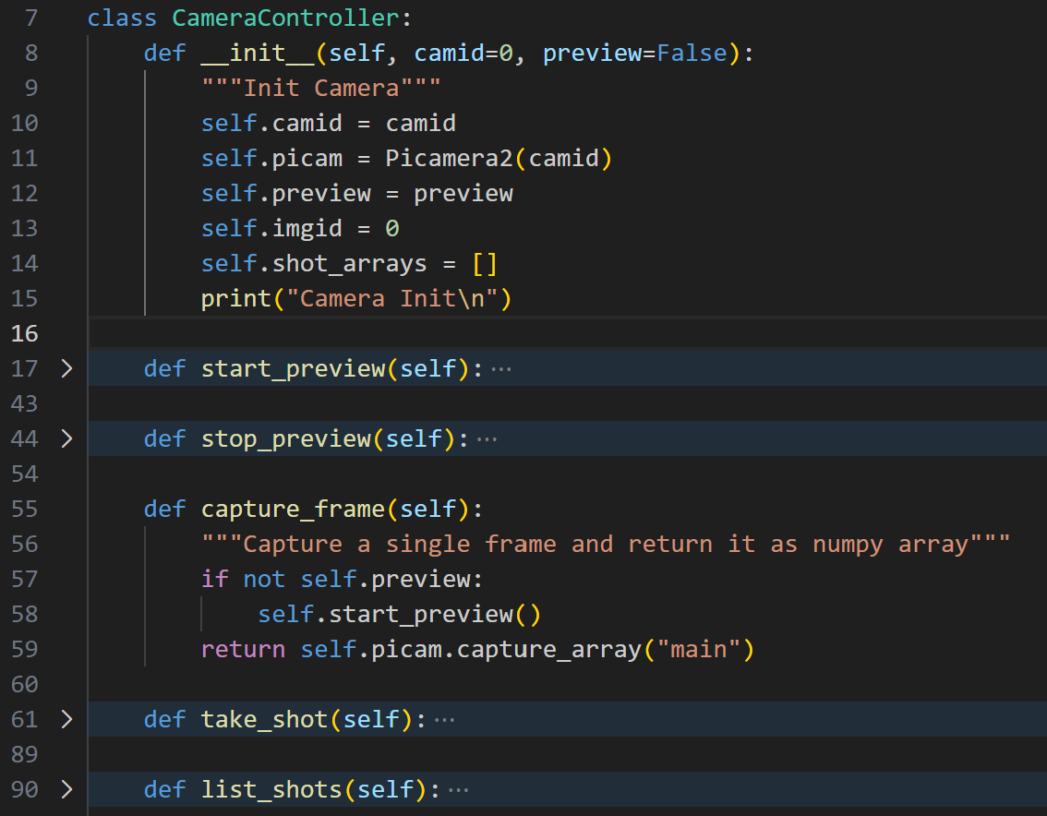

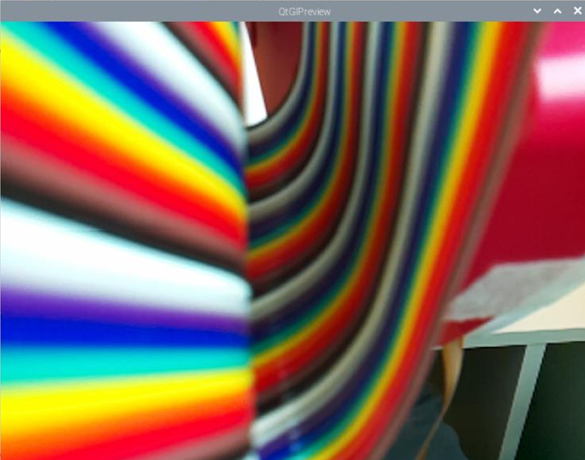
Camera and Image
In this project, the p5v04a camera is used. And python library picamera2 is utilized to drive the camera and capture images.
A SW module CameraController is developed for the camera manipulation. Several applications are considered but we are using “capture_frame” for returning the pixel array for utilization.

Slide 9

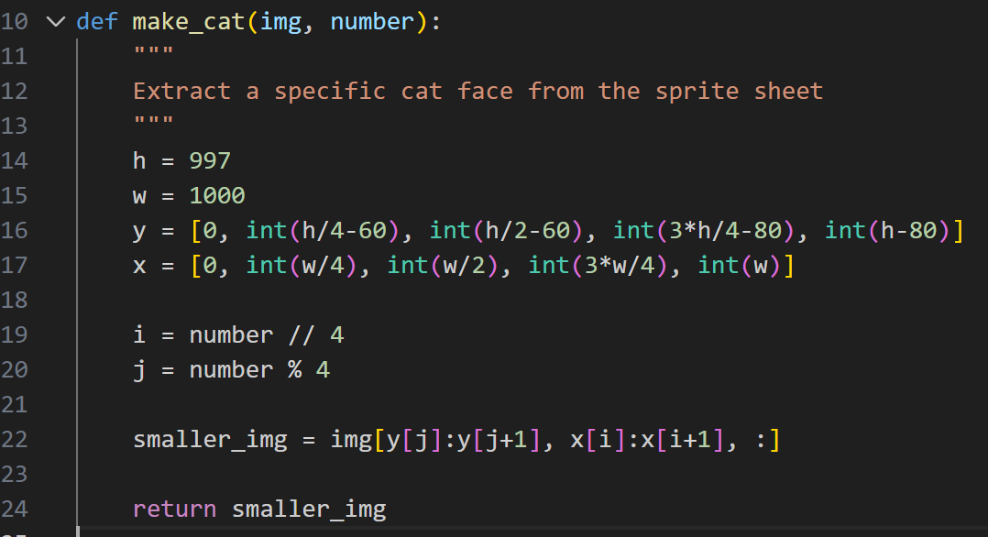
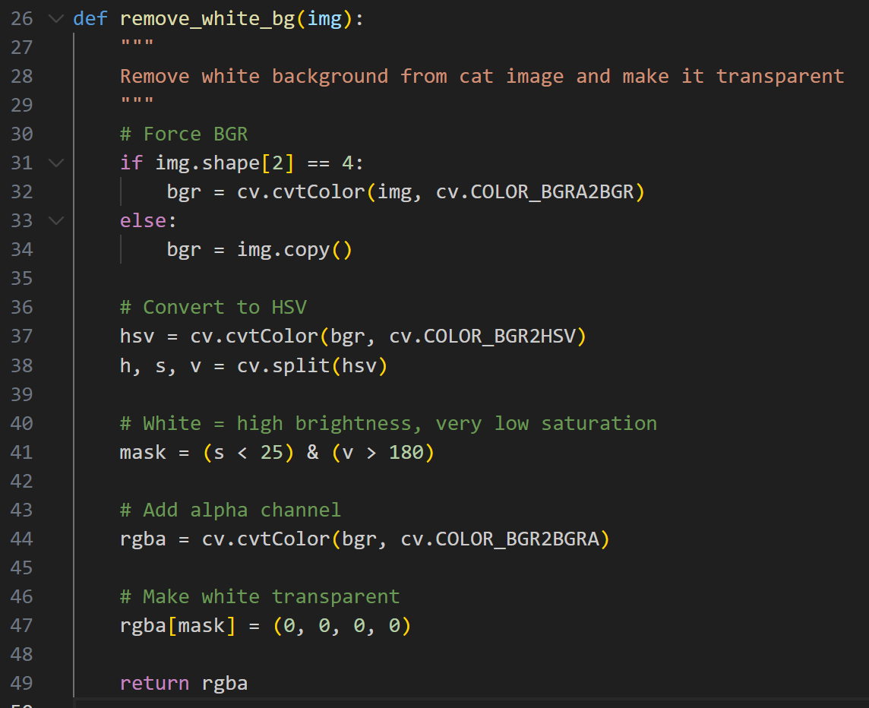
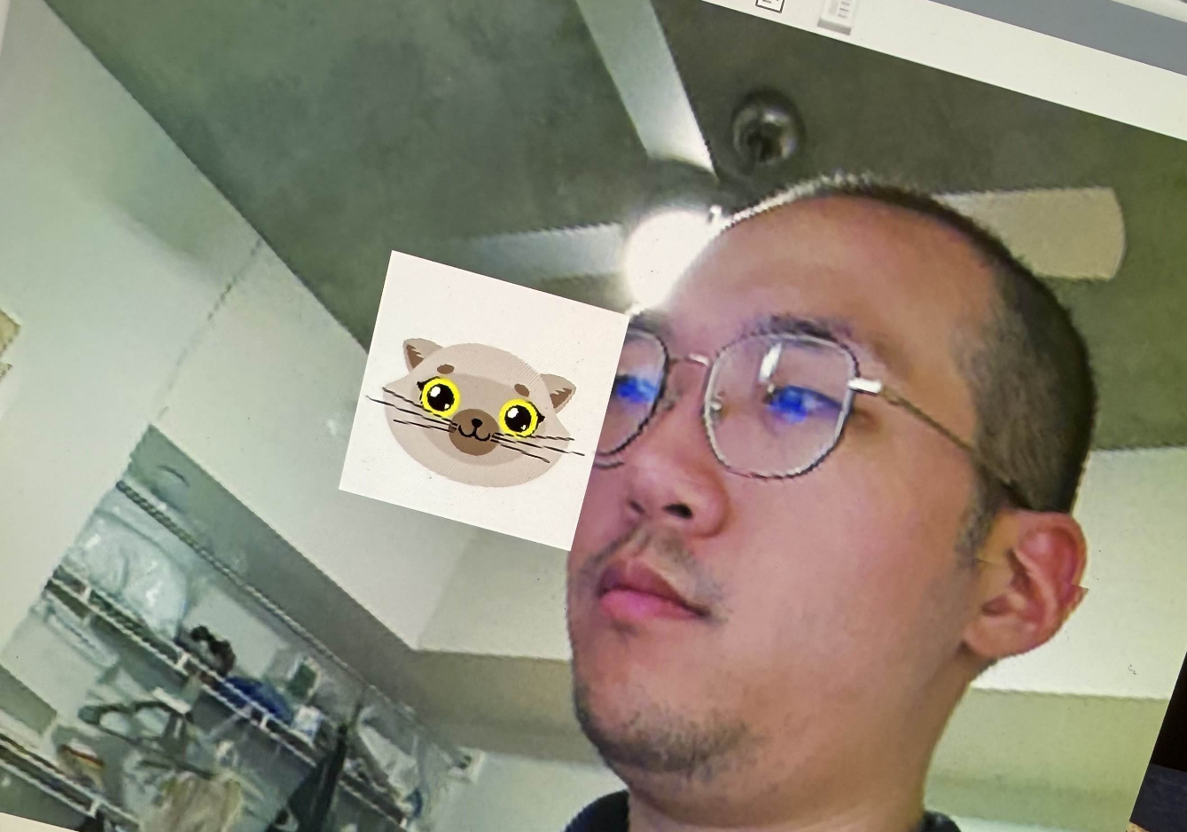
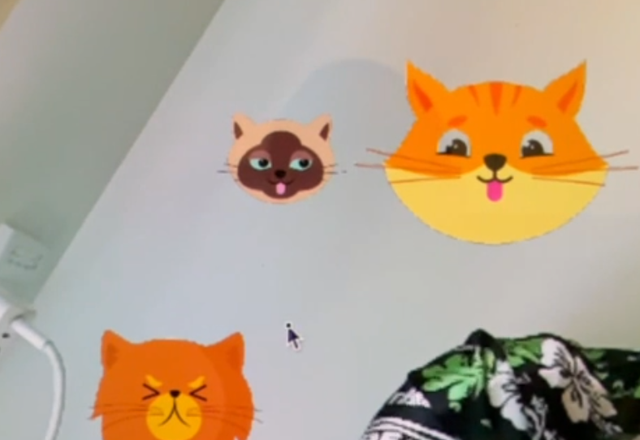
Cat Face Cropping and BG Removal
2
1
There are 2 major parts for getting the cat faces.
Cropping and background removal.
Removing Background with masking on brightness and saturation. And put it to transparent.
In our masking, we have:
Saturation < 25 &
Brightness > 180
First utilizing the example code to crop the faces according to the index.

Slide 10
2
Face Detection
Using Haar Cascade to detect faces on RPi 5

Slide 11
Haar Cascade Algorithm - I
Fundamental
Detection Pipeline
Haar Features: Rectangular patterns to capture intensity differences between adjacent regions
Feature calculation in constant time O(1)
Series of stages (typically 20-30) with increasing complexity
Early stages reject obvious non-faces quickly
Grayscale Conversion
Image pyramid created using scaleFactor parameter (e.g., 1.1 = 10% increments)
Each stage acts as binary classifier
Non-Maximum Suppression using minNeighbors parameter

Slide 12
Haar Cascade Algorithm - II
Strict Frontal Requirement
Environmental Limitations
Training data bias (Pre-trained on frontal face samples)
Feature rigidity: Encode fixed geometric relationships between facial regions
Lacks inherent mechanism to handle in-plane or out-of-plane rotation
Separate classifiers for profile views
Poor performance in Low light, high contrast
Partial face coverage causes detection failures due to rigid feature matching
Cluttered environments increase false positives; parameter tuning cannot fully mitigate

Slide 13
Challenges & Troubleshooting
Critical Parameters
RPi5 System Stability
scaleFactor (e.g., 1.05-1.3): Lower = more accurate but slower
minNeighbors (e.g., 3-6): Higher = fewer false positives
minSize / maxSize: Constraining search space
cv2.CASCADE_SCALE_IMAGE): memory/speed trade-off
Full-resolution processing - system shutdown
Resolution Trade-Off Strateg
picamera2 Buffer Management helped but unexpected slowing

Slide 14
Emoji vs Dominant Dress color
Upper Body Region selection
Dominant Color Selection
Based on average human proportions
Upper torso is about 1.5 times the face height
Shoulders are wider than the face
body_height = int(h * 1.5)
body_width = int(w * 1.8)
:
# Crop and return the upper-body region
region = frame[top:bottom, left:right]
Histogram and modeling results were poor
Using K-Means clustering was more accurate
simple RGB heuristics to filter out skin and not get confused with clothing color

Slide 15
3
Future Work

Slide 16
Future Work
Address limitations
Face Recognition
Orientation agnostic detectors
Robustness e.g lighting compensation
Use DNN recognition for Privacy preserving tools e.g. masking minors
Edge Cloud Distributed
RPi 5 edge device offloading recognition to cloud

